Slide 1
Advanced Data Analysis 367-2-5461
Opher Donchin

Slide 2
Topics
Homework
Covariance models
Cafes
Chimpanzee example
Instrumental variables
Social relations model
Gaussian process models
Tool use
Phylogenetic tree

Slide 3
BMCP 2E6
Comparing a Poisson and negative Binomial fit

Slide 4
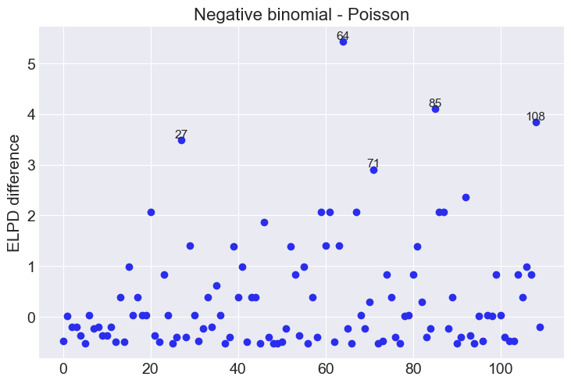
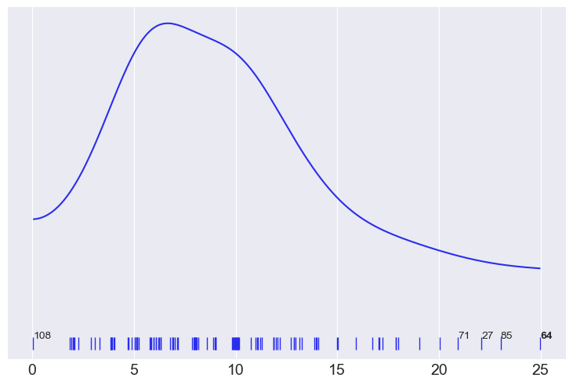
Pointwise ELPD
# Jitter the observations so that aren't all plotted on top of each other
y_obs = pois_idata.observed_data.y.values + np.random.normal(loc=0, scale=0.15, size=len(pois_idata.observed_data.y.values))
az.plot_kde(y_obs, adaptive=True, rug=True)
plt.yticks([])
loc = -0.015
for da in [27, 71, 85, 108]:
plt.text(y_obs[da], loc, f"{da}")
plt.text(y_obs[64], loc, "64", fontweight='bold');
az.plot_elpd(idatas, threshold=2)

Slide 5
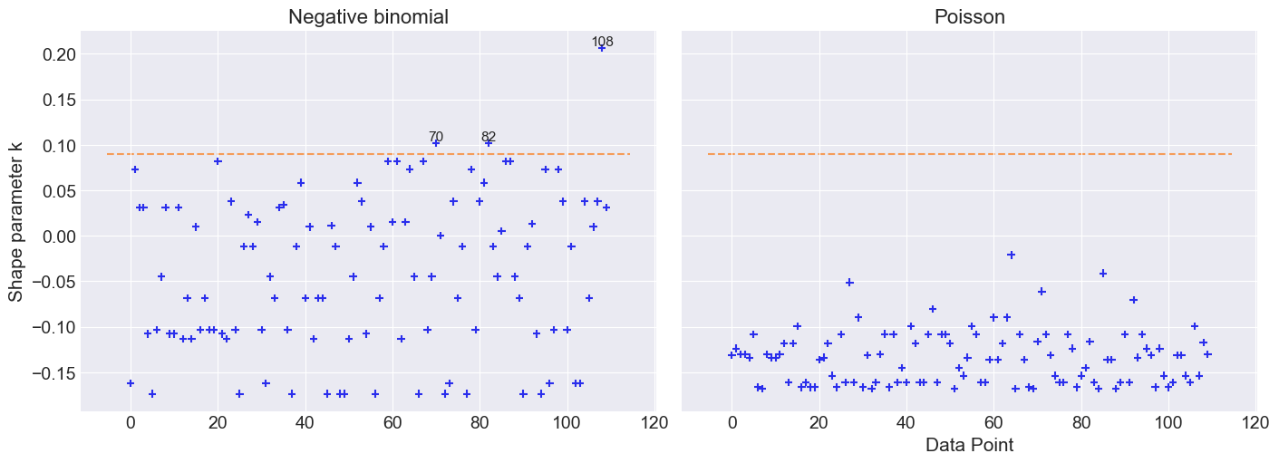

Examine Pareto $κ$ values
https://www.desmos.com/calculator/7a6zcqepn4
_, axes = plt.subplots(1, 2, figsize=(14, 5), sharey=True)
for idx, (key, ax) in enumerate(zip(idatas.keys(), axes)):
loo_ = az.loo(idatas[key], pointwise=True)
az.plot_khat(loo_, ax=ax, threshold=0.09, show_hlines=True, hlines_kwargs={"hlines":0.09, "ls":"--"})
ax.set_title(key)
if idx:
axes[idx].set_ylabel("")
if not idx % 2:
axes[idx].set_xlabel("")

Slide 6
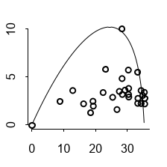
SR 7H1
Alternative fits for the Laffer curve “fit” to data from a bunch of countries that appeared in the Wall Street Journal
The Laffer “curve”:
When tax rate is 0%, there can be no revenue
When tax rate is 100%, there will be no revenue
There must be a maximum somewhere

Slide 7
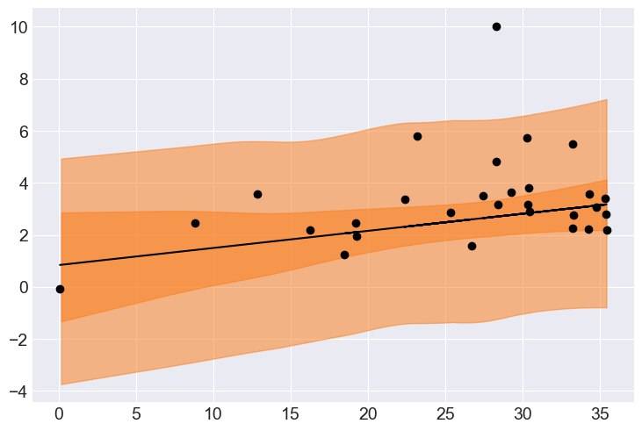

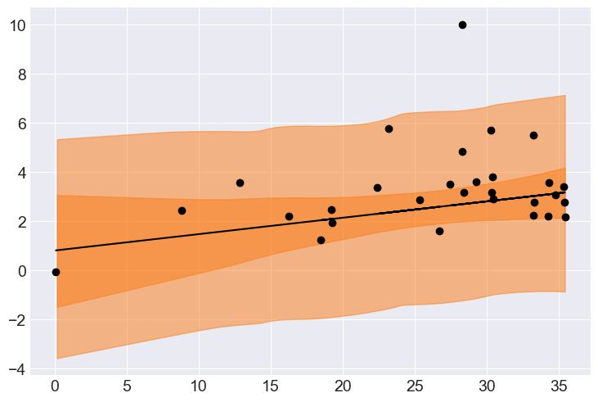
Fitting polynomials
Doesn’t like a huge difference in the fit
Wouldn’t be surprised if linear was the best model
Linear
Quadratic
Cubic

Slide 8
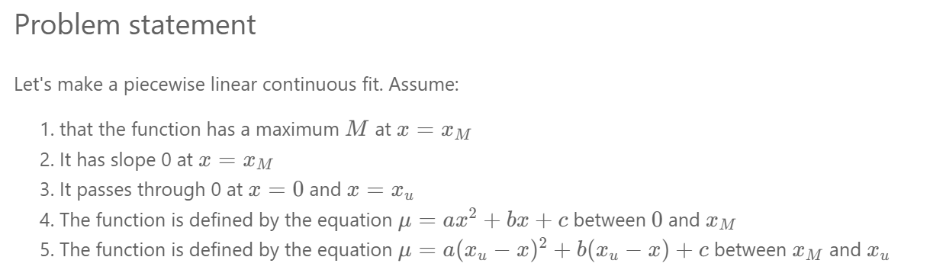
My constrained model
Maybe I should publish it

Slide 9
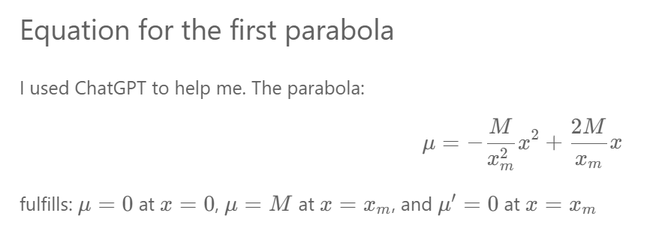
A little algebra
We will need parameters $M$ and $x_{m}$ for the fit

Slide 10
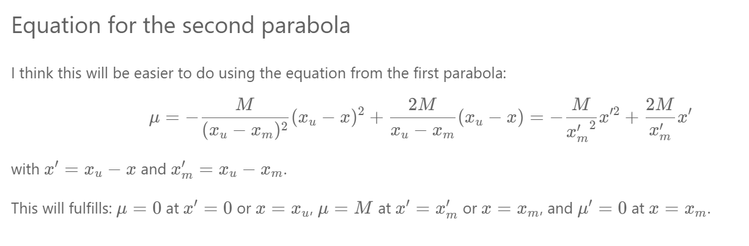


The second parabola
I will do this in the model by creating a new variable
One more parameter: $x_{u}$

Slide 11
The model
Use of switch to choose parabola
with pm.Model(coords=coords) as m_bounded:
x_obs = pm.ConstantData("x_obs", x/100) # Convert x to percentages
# Parameters
σ = pm.Gamma("σ", mu=σ_μ, sigma=σ_σ)
x_u = pm.Beta("x_u", alpha=x_u_alpha, beta=x_u_beta)
x_m_u = pm.Beta("x_m_u", alpha=x_m_u_alpha, beta=x_m_u_beta)
M = pm.Gamma("M", mu=M_μ, sigma=M_σ)
# Constrained math from above
x_m = pm.Deterministic("x_m", x_m_u*x_u)
x_combined = pm.math.switch(x_obs < x_m, x_obs, x_u-x_obs)
x_m_combined = pm.math.switch(x_obs < x_m, x_m, x_u-x_m)
μ = pm.Deterministic("μ", -(M / (x_m_combined**2))*(x_combined**2) + 2*(M / x_m_combined)*x_combined, dims="data")
# Likelihood
y_obs = pm.Normal("y_obs", mu=μ, sigma=σ, observed=y, dims="data")

Slide 12
The priors
Use data to get reasonable priors
Check prior predictive (and diagnostics)
# Noise around the line
σ_mode = y.std()
σ_σ = 2*y.std()
σ_μ = gamma_mean_from_mode(m=σ_mode, s=σ_σ)
# x_u tends weakly towards 1
x_u_alpha = 3
x_u_beta = 1
# x_m tends weakly towards the middle of the range
x_m_u_alpha = 2
x_m_u_beta = 2
# M tends towards the maximum of the data
M_mode = y.max()
M_σ = 3*y.std()
M_μ = gamma_mean_from_mode(m=M_mode, s=M_σ)

Slide 13
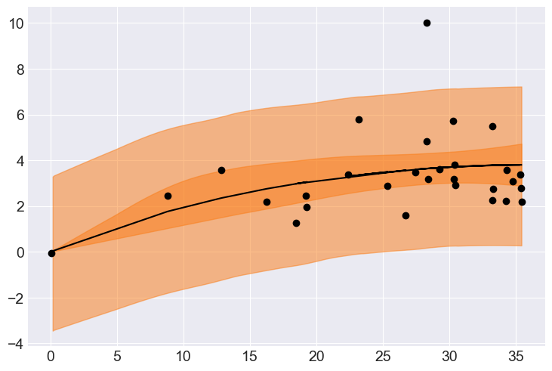
The fit
Quadratic
Constrained

Slide 14
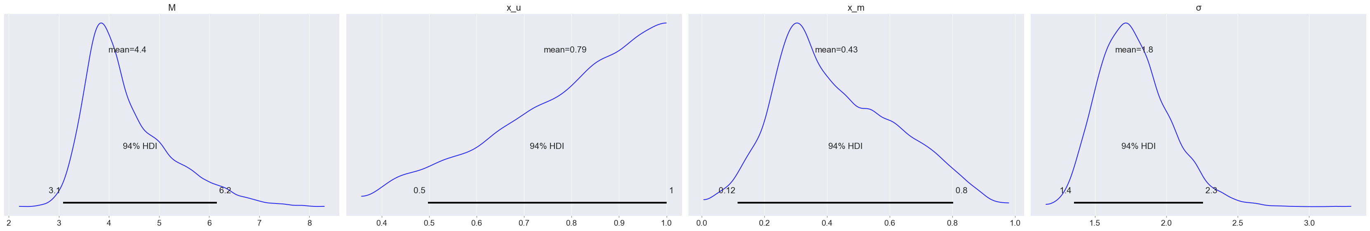
The parameters of the fit
Optimal tax rate is somewhere between 12% and 80%

Slide 15
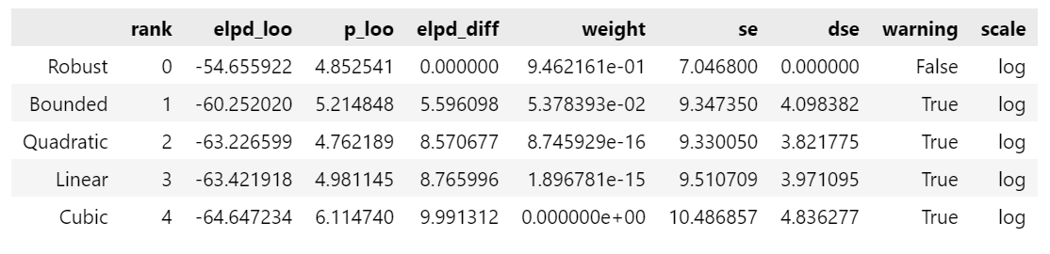
Model comparison
Adding a Student’s t likelihood improves the model
Although not by a full standard error
But it does improve the model comparison Pareto fit
I should have tried a gamma likelihood

Slide 16
Topics
Homework
Covariance models
Cafes
Chimpanzee example
Instrumental variables
Social relations model
Gaussian process models
Tool use
Phylogenetic tree

Slide 17
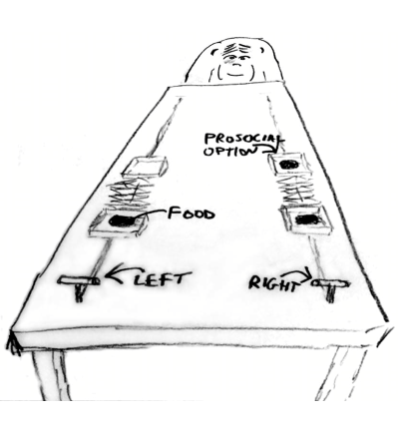
Chimpanzee pro-social behavior
The focal animal always gets food
Conditions
Other tray has food left or right
Partner animal present or absent
Outcome variable
Pulled left

Slide 18
Non-hierarchical model
a: tendency of each monkey to pull left
b: effect of condition
with pm.Model() as m11_4:
a = pm.Normal("a", 0.0, 1.5, shape=len(actors))
b = pm.Normal("b", 0.0, 0.5, shape=len(treatments))
actor_id = pm.intX(pm.MutableData("actor_id", actor_idx))
treat_id = pm.intX(pm.MutableData("treat_id", treat_idx))
p = pm.Deterministic("p", pm.math.invlogit(a[actor_id] + b[treat_id]))
pulled_left = pm.Binomial("pulled_left", 1, p, observed=d.pulled_left)

Slide 19
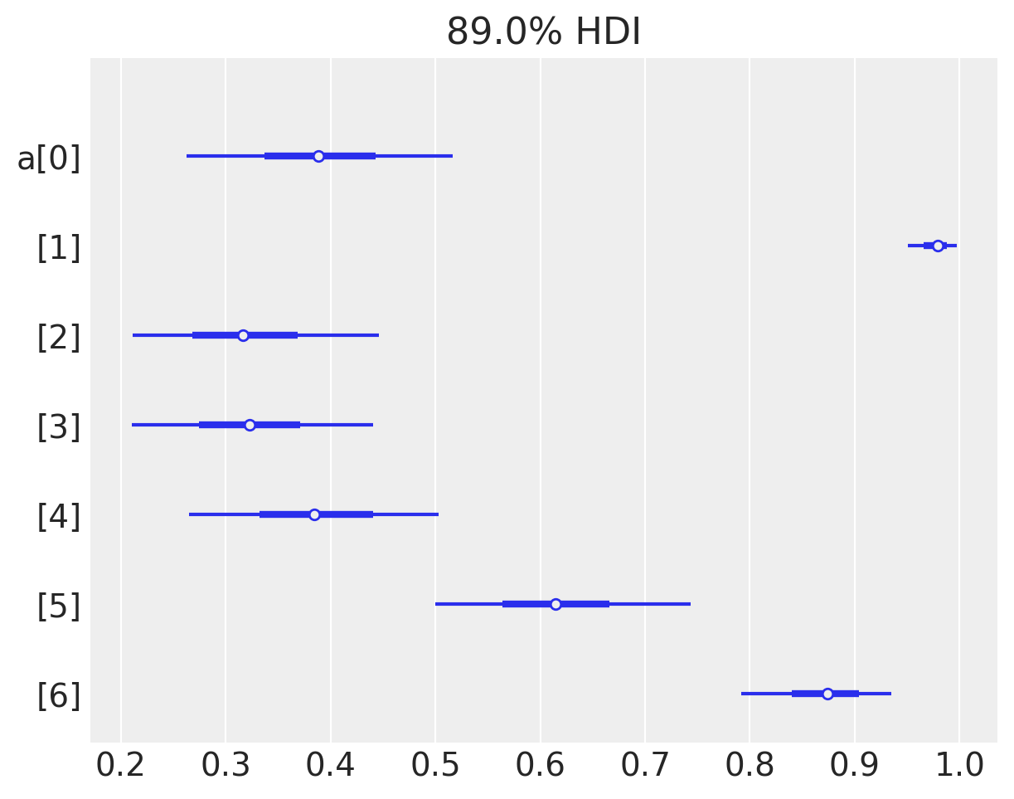
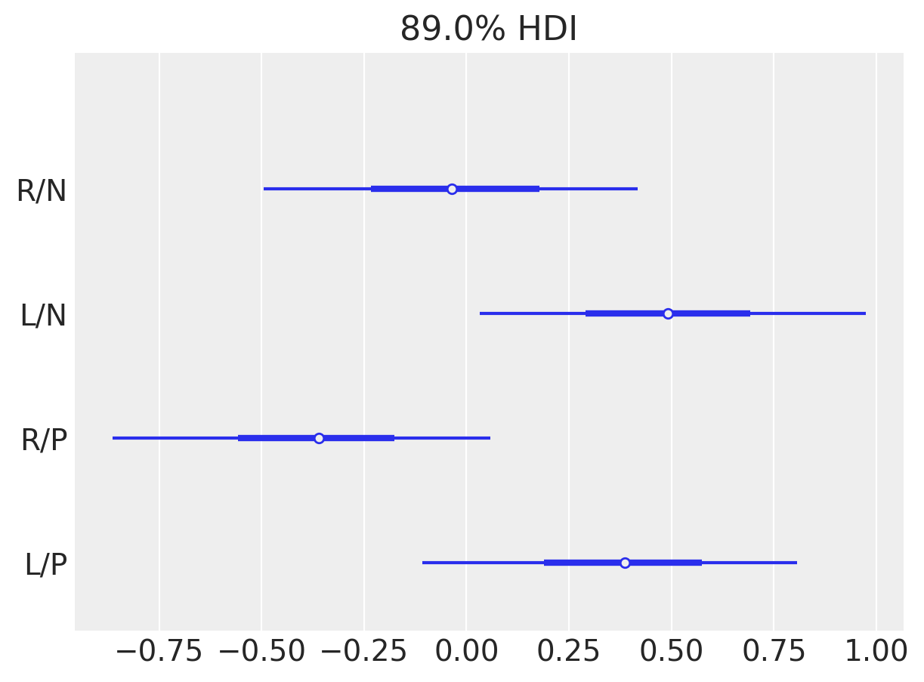
Results
Each monkey has a tendency
Food location matters
Partner matters
az.plot_forest(idata_11_4, var_names=["a"], transform=logistic, combined=True);
ax = az.plot_forest(idata_11_4, var_names=["b"], combined=True)
ax[0].set_yticklabels(["L/P", "R/P", "L/N", "R/N"]);

Slide 20
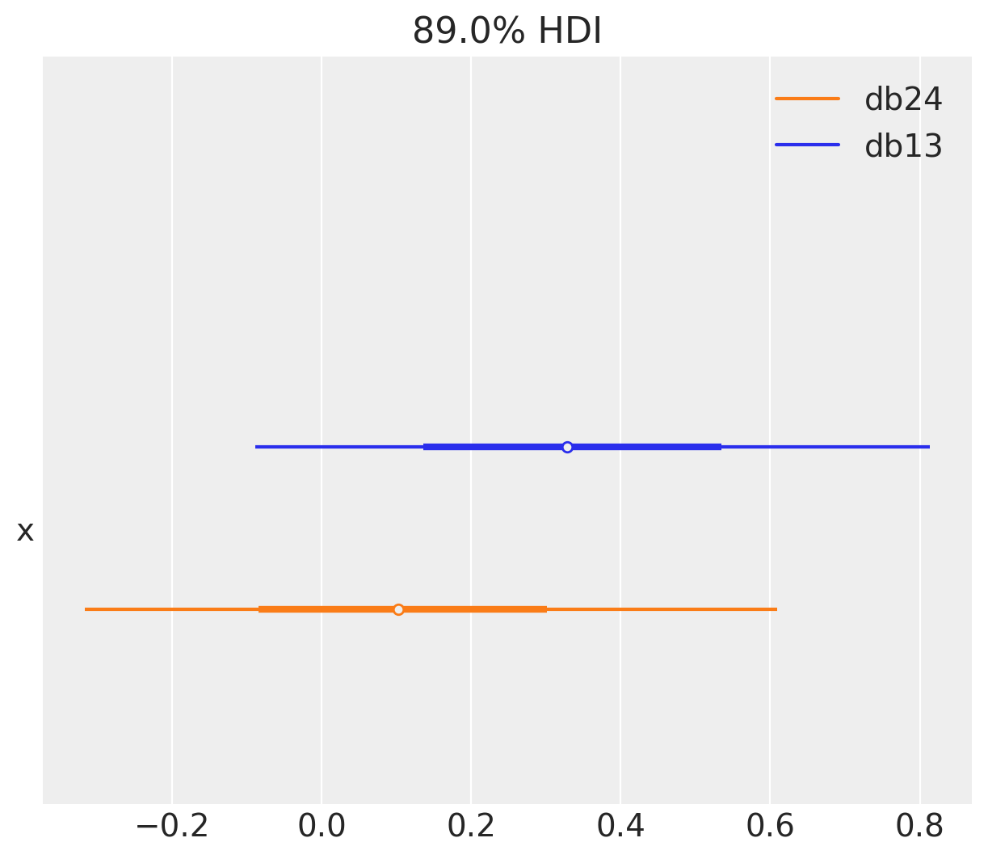
Plot effects
db13 = idata_11_4.posterior["b"].sel(b_dim_0=0) - idata_11_4.posterior["b"].sel(b_dim_0=2)
db24 = idata_11_4.posterior["b"].sel(b_dim_0=1) - idata_11_4.posterior["b"].sel(b_dim_0=3)
az.plot_forest([db13.values, db24.values], model_names=["db13", "db24"], combined=True);

Slide 21
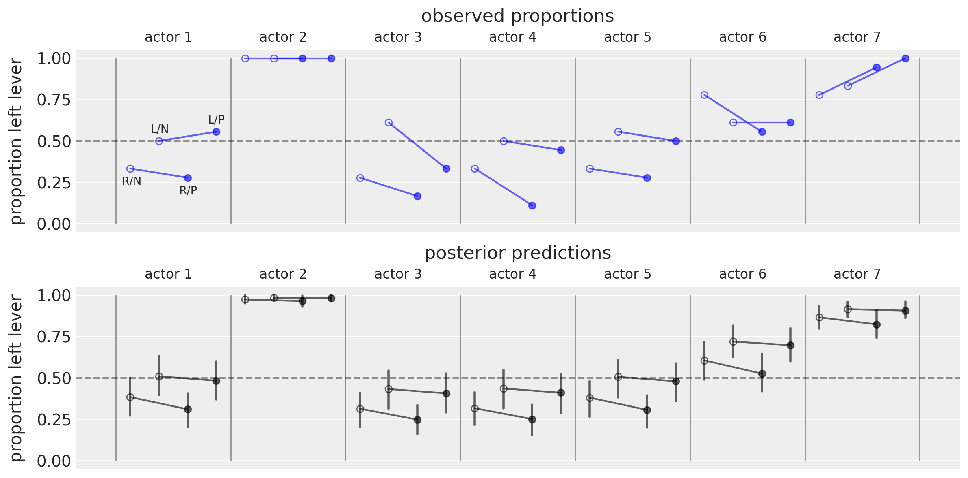
Posterior predictions

Slide 22
A hierarchical model
Each chimpanzee has preferences for each condition
These may correlated with each other (across chimpanzees)
Each monkey repeated each treatment 3 times in each block of trials (separate days?)

Slide 23
In PyMC
Centered model
with pm.Model() as m14_2:
# fixed priors
g = pm.Normal("g", mu=0.0, sigma=1.0, shape=Ntreatments)
sd_dist = pm.Exponential.dist(1.0)
chol_actor, _, _ = pm.LKJCholeskyCov(
"chol_actor", n=Ntreatments, eta=4, sd_dist=sd_dist, compute_corr=True
)
chol_block, _, _ = pm.LKJCholeskyCov(
"chol_block", n=Ntreatments, eta=4, sd_dist=sd_dist, compute_corr=True
)
# adaptive priors
alpha = pm.MvNormal("alpha", mu=0.0, chol=chol_actor, shape=(Nactors, Ntreatments))
beta = pm.MvNormal("beta", mu=0.0, chol=chol_block, shape=(Nblocks, Ntreatments))
# for posterior predictions
actor = pm.Data("actor", actor_)
block_id = pm.Data("block_id", block_id_)
tid = pm.Data("tid", tid_)
p = pm.math.invlogit(g[tid] + alpha[actor, tid] + beta[block_id, tid])
pulled_left = pm.Binomial("pulled_left", 1, p, observed=d.pulled_left)

Slide 24
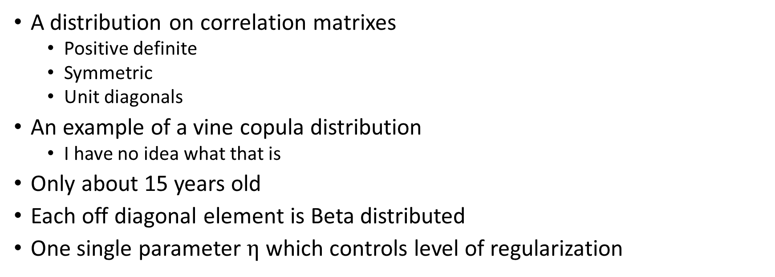
The Lewandowski-Kurowicka-Joe distribution
chol_actor, _, _ = pm.LKJCholeskyCov(
"chol_actor", n=Ntreatments, eta=4, sd_dist=sd_dist, compute_corr=True
)
A distribution on correlation matrixes
Positive definite
Symmetric
Unit diagonals
An example of a vine copula distribution
I have no idea what that is
Only about 15 years old
Each off diagonal element is Beta distributed
One single parameter $η$ which controls level of regularization

Slide 25
Cholesky factorization
Decompose correlation matrix into upper and lower triangular matrixes
Can be passed as parameter to multivariate normal

Slide 26
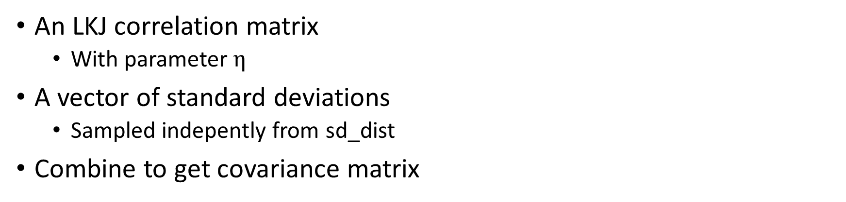
The LKJ covariance matrix
chol_actor, _, _ = pm.LKJCholeskyCov(
"chol_actor", n=Ntreatments, eta=4, sd_dist=sd_dist, compute_corr=True
)
An LKJ correlation matrix
With parameter $η$
A vector of standard deviations
Sampled indepently from sd_dist
Combine to get covariance matrix

Slide 27
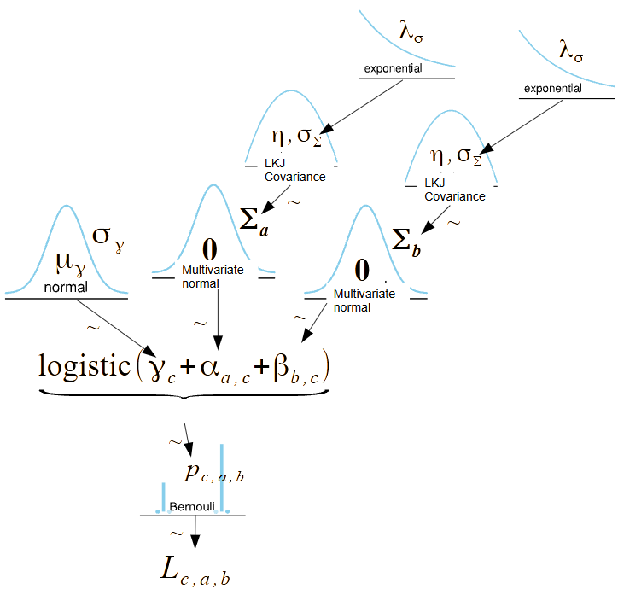
Kruschke diagram
The LKJ is used as a prior for the covariance matrix
The covariance matrix determines the correlation in the coefficients for the different conditions
The correlation determines how much:
A chimp chooses the same direction
A chimp cares about the food location
A chimp cares about partner

Slide 28
The model again (centered)
with pm.Model() as m14_2:
# fixed priors
g = pm.Normal("g", mu=0.0, sigma=1.0, shape=Ntreatments)
sd_dist = pm.Exponential.dist(1.0)
chol_actor, _, _ = pm.LKJCholeskyCov(
"chol_actor", n=Ntreatments, eta=4, sd_dist=sd_dist, compute_corr=True
)
chol_block, _, _ = pm.LKJCholeskyCov(
"chol_block", n=Ntreatments, eta=4, sd_dist=sd_dist, compute_corr=True
)
# adaptive priors
alpha = pm.MvNormal("alpha", mu=0.0, chol=chol_actor, shape=(Nactors, Ntreatments))
beta = pm.MvNormal("beta", mu=0.0, chol=chol_block, shape=(Nblocks, Ntreatments))
# for posterior predictions
actor = pm.Data("actor", actor_)
block_id = pm.Data("block_id", block_id_)
tid = pm.Data("tid", tid_)
p = pm.math.invlogit(g[tid] + alpha[actor, tid] + beta[block_id, tid])
pulled_left = pm.Binomial("pulled_left", 1, p, observed=d.pulled_left)

Slide 29
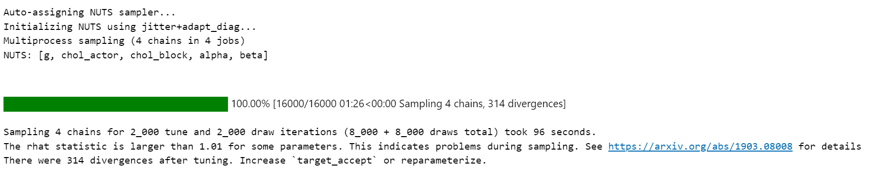
Divergences!

Slide 30
The model (non-centered)
with pm.Model() as m14_3:
# fixed priors
g = pm.Normal("g", mu=0.0, sigma=1.0, shape=Ntreatments)
sd_dist = pm.Exponential.dist(1.0)
chol_actor, _, _ = pm.LKJCholeskyCov(
"chol_actor", n=Ntreatments, eta=4, sd_dist=sd_dist, compute_corr=True
)
chol_block, _, _ = pm.LKJCholeskyCov(
"chol_block", n=Ntreatments, eta=4, sd_dist=sd_dist, compute_corr=True
)
# adaptive priors non-centered
z_actor = pm.Normal("z_actor", 0.0, 1.0, shape=(Ntreatments, Nactors))
alpha = pm.Deterministic("alpha", pm.math.dot(chol_actor, z_actor))
z_block = pm.Normal("z_block", 0.0, 1.0, shape=(Ntreatments, Nblocks))
beta = pm.Deterministic("beta", pm.math.dot(chol_block, z_block))
# for posterior predictions
actor = pm.MutableData("actor", actor_)
block_id = pm.MutableData("block_id", block_id_)
tid = pm.MutableData("tid", tid_)
p = pm.Deterministic("p", pm.math.invlogit(g[tid] + alpha[tid, actor] + beta[tid, block_id]))
pulled_left = pm.Binomial("pulled_left", 1, p, observed=d.pulled_left)

Slide 31
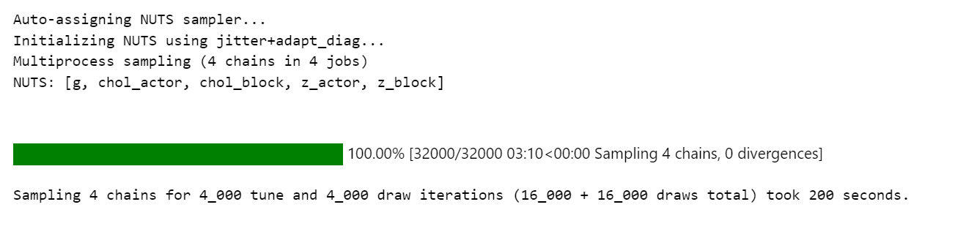
No divergences!

Slide 32
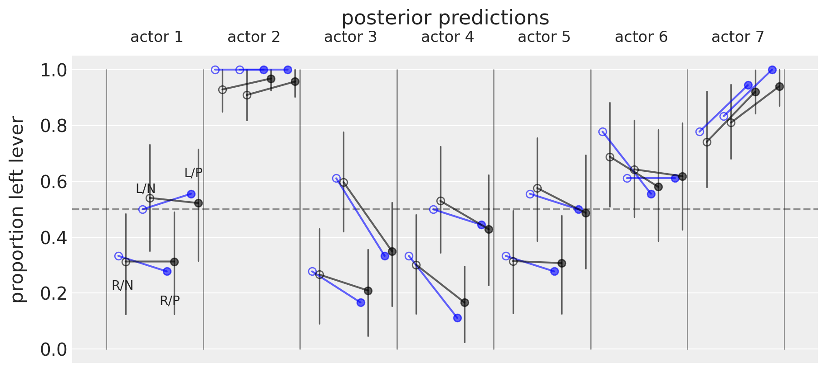
Results

Slide 33
Topics
Homework
Covariance models
Cafes
Chimpanzee example
Instrumental variables
Social relations model
Gaussian process models
Tool use
Phylogenetic tree

Slide 34
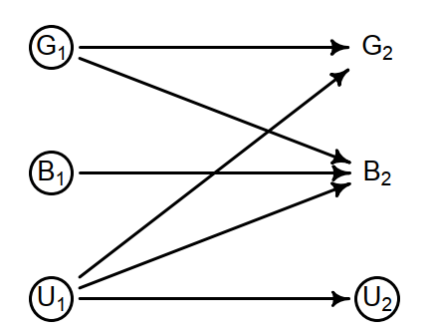
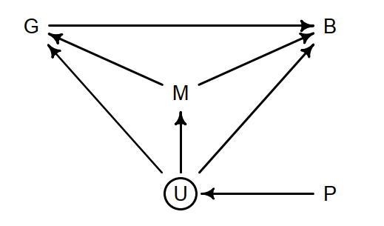
How does group size affect brain size?
This is an evolutionary process
We use phylogeny because we can’t measure across time
Phylogeny is being used as an instrumental variable

Slide 35
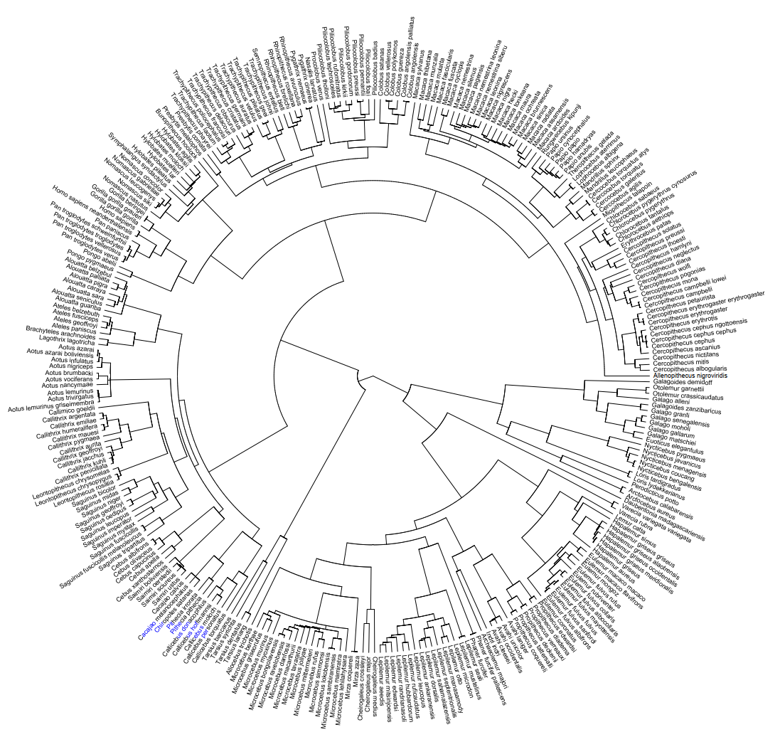
Phylogeny is complex
We take the phylogenetic tree as given
Even though it does change

Slide 36
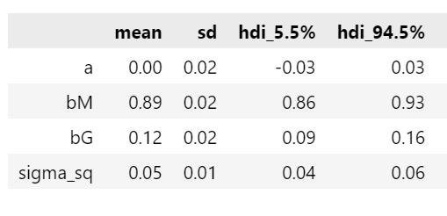
Let’s start by seeing if there is any relation
Imat is an identity matrix
This just a regular regression in fancy dress
with pm.Model() as m14_9:
a = pm.Normal("a", 0.0, 1.0)
bM = pm.Normal("bM", 0.0, 0.5)
bG = pm.Normal("bG", 0.0, 0.5)
sigma_sq = pm.Exponential("sigma_sq", 1.0)
mu = a + bM * M + bG * G
SIGMA = Imat * sigma_sq
B = pm.MvNormal("B", mu, cov=SIGMA, observed=B_)

Slide 37
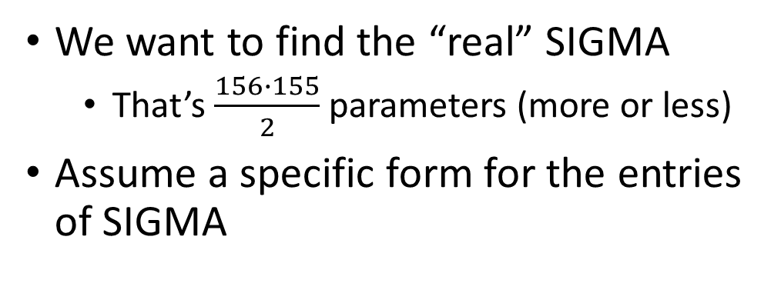
Guassian process model
We want to find the “real” SIGMA
That’s $\frac{156∙155}{2}$ parameters (more or less)
Assume a specific form for the entries of SIGMA
with pm.Model() as m14_9:
a = pm.Normal("a", 0.0, 1.0)
bM = pm.Normal("bM", 0.0, 0.5)
bG = pm.Normal("bG", 0.0, 0.5)
sigma_sq = pm.Exponential("sigma_sq", 1.0)
mu = a + bM * M + bG * G
SIGMA = Imat * sigma_sq
B = pm.MvNormal("B", mu, cov=SIGMA, observed=B_)

Slide 38
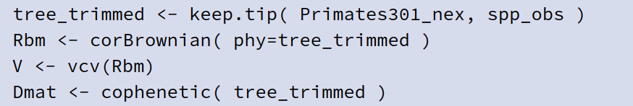
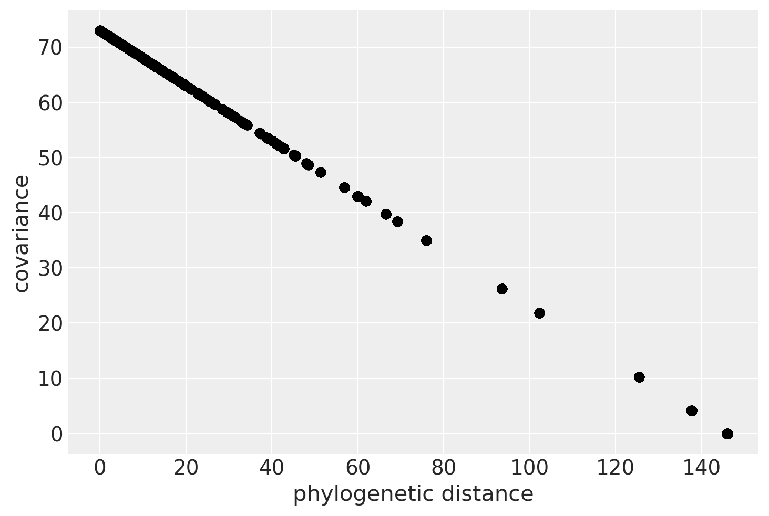
One possibility: proportional
Still only one parameter
# Brownian motion model
with pm.Model() as m14_10:
a = pm.Normal("a", 0.0, 1.0)
bM = pm.Normal("bM", 0.0, 0.5)
bG = pm.Normal("bG", 0.0, 0.5)
sigma_sq = pm.Exponential("sigma_sq", 1.0)
mu = a + bM * M + bG * G
SIGMA = R * sigma_sq
B = pm.MvNormal("B", mu, cov=SIGMA, observed=B_)צ

Slide 39
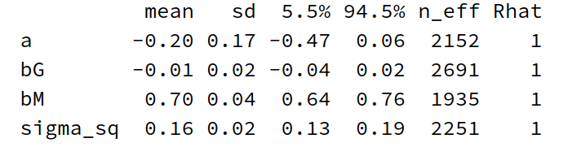
Now group doesn’t affect brain at all
Still only one parameter
# Brownian motion model
with pm.Model() as m14_10:
a = pm.Normal("a", 0.0, 1.0)
bM = pm.Normal("bM", 0.0, 0.5)
bG = pm.Normal("bG", 0.0, 0.5)
sigma_sq = pm.Exponential("sigma_sq", 1.0)
mu = a + bM * M + bG * G
SIGMA = R * sigma_sq
B = pm.MvNormal("B", mu, cov=SIGMA, observed=B_)צ

Slide 40
We want a more flexible correlation structure
Ornstein-Uhlenbeck process
This is called the kernel of the Gaussian process
There are standard kernels and you can make your own

Slide 41
The model with an OU kernel
An exponential form for the covariance matrix is provided
with pm.Model() as m14_11:
a = pm.Normal("a", 0.0, 1.0)
b = pm.Normal("b", 0.0, 0.5, shape=2)
# specify the mean function:
mu = LinearMean(intercept=a, slopes=b)
# half_normal(1, 0.25) is too strong
etasq = pm.Exponential("etasq", 1.0)
rhosq = pm.Normal("rhosq", 3.0, 0.25)
# specify the covariance function:
SIGMA = etasq * pm.gp.cov.Exponential(input_dim=1, ls=rhosq)
# specify the GP:
gp = pm.gp.Marginal(mean_func=mu, cov_func=SIGMA)
# place a GP prior over the observations.
# SIGMA will be conditioned on Dmat_ord.
# mu won't be, as we coded it on purpose.
sigma = pm.Exponential("sigma", 1.0)
B = gp.marginal_likelihood("B", X=Dmat_ord, y=B_, noise=sigma)
This line generates a new likelihood distribution
This line connects the likelihood distribution to the data

Slide 42
Use a GP subclass to the the mean
Similarly simple code can be used to modify most aspects of PyMC
class LinearMean(pm.gp.mean.Mean):
def __init__(self, intercept, slopes):
self.intercept = intercept
self.slopes = slopes
def __call__(self, X):
"""In the trace summary, b0 will be bM and b1 will be bG"""
return self.intercept + self.slopes[0] * M + self.slopes[1] * G
with pm.Model() as m14_11:
a = pm.Normal("a", 0.0, 1.0)
b = pm.Normal("b", 0.0, 0.5, shape=2)
# specify the mean function:
mu = LinearMean(intercept=a, slopes=b)
# half_normal(1, 0.25) is too strong
etasq = pm.Exponential("etasq", 1.0)
rhosq = pm.Normal("rhosq", 3.0, 0.25)
# specify the covariance function:
SIGMA = etasq * pm.gp.cov.Exponential(input_dim=1, ls=rhosq)
# specify the GP:
gp = pm.gp.Marginal(mean_func=mu, cov_func=SIGMA)
# place a GP prior over the observations.
# SIGMA will be conditioned on Dmat_ord.
# mu won't be, as we coded it on purpose.
sigma = pm.Exponential("sigma", 1.0)
B = gp.marginal_likelihood("B", X=Dmat_ord, y=B_, noise=sigma)

Slide 43
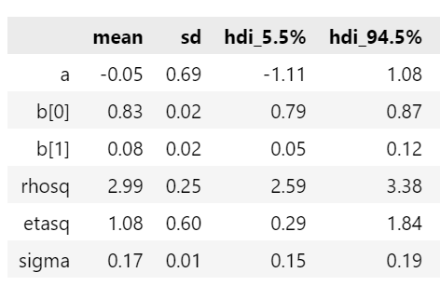
Use a GP subclass to the the mean
Similarly simple code can be used to modify most aspects of PyMC
with pm.Model() as m14_11:
a = pm.Normal("a", 0.0, 1.0)
b = pm.Normal("b", 0.0, 0.5, shape=2)
# specify the mean function:
mu = LinearMean(intercept=a, slopes=b)
# half_normal(1, 0.25) is too strong
etasq = pm.Exponential("etasq", 1.0)
rhosq = pm.Normal("rhosq", 3.0, 0.25)
# specify the covariance function:
SIGMA = etasq * pm.gp.cov.Exponential(input_dim=1, ls=rhosq)
# specify the GP:
gp = pm.gp.Marginal(mean_func=mu, cov_func=SIGMA)
# place a GP prior over the observations.
# SIGMA will be conditioned on Dmat_ord.
# mu won't be, as we coded it on purpose.
sigma = pm.Exponential("sigma", 1.0)
B = gp.marginal_likelihood("B", X=Dmat_ord, y=B_, noise=sigma)

Slide 44
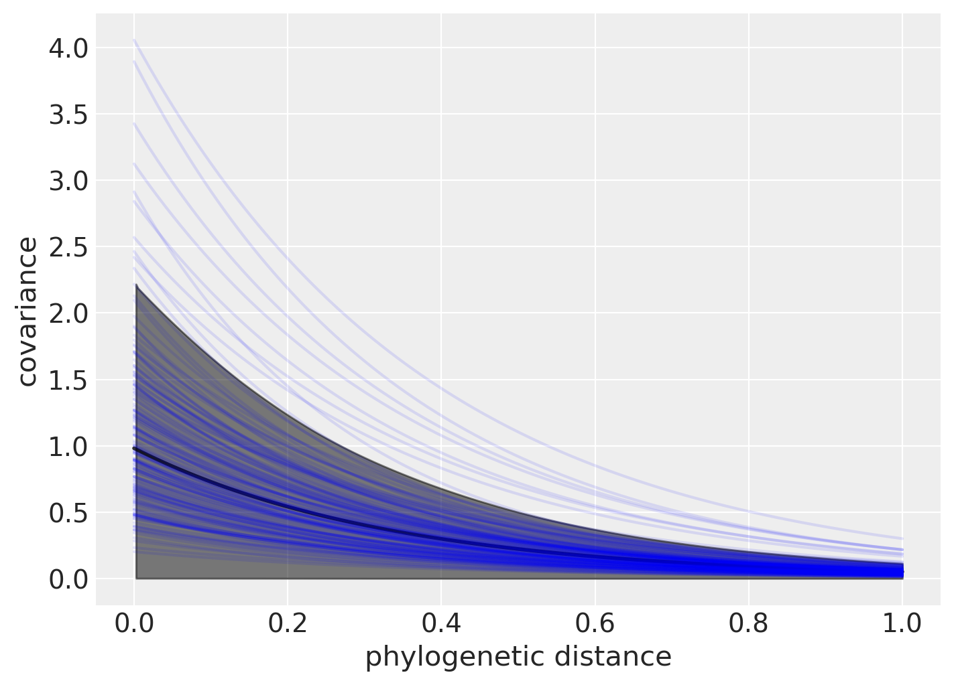
What does the covariance function look like?
We can check
d_seq = np.linspace(0, Dmat_ord.max(), 100)
post = idata_14_11.posterior.stack(sample=("chain", "draw"))
_, ax = plt.subplots(1, 1, figsize=(7, 5))
# prior mean and 89% interval
eta = np.random.exponential(1.0, 1000)
rho = np.random.normal(3.0, 0.25, 1000)
K = []
for d in d_seq:
K.append(eta * np.exp(-rho * d))
K = np.asarray(K)
ax.plot(d_seq, K.mean(1), "k", alpha=0.8, lw=2)
az.plot_hdi(d_seq, K.T, color="k", ax=ax)
# posterior
post_etasq = post["etasq"][::50].values[:, None]
post_rhosq = post["rhosq"][::50].values[:, None]
ax.plot(d_seq, (post_etasq * np.exp(-post_rhosq * d_seq)).T, "b", alpha=0.1)
ax.set(xlabel="phylogenetic distance", ylabel="covariance");

Slide 45
Topics
Homework
Covariance models
Cafes
Chimpanzee example
Instrumental variables
Social relations model
Gaussian process models
Tool use
Phylogenetic tree

